Slide 2
Going beyond guidelines: HIV-1 drug resistance testing at low-level viremia, a South African experience
Avania Bangalee¹ , Kim Steegen² , Sergio Carmona², Lucia Hans²
1.Department of Medical Virology, National Health Laboratory Services/University of the Witwatersrand, South Africa
2.Department of Haematology and Molecular Medicine, National Health Laboratory Services/University of the Witwatersrand, South Africa
Share your thoughts on this presentation with #IAS2019

Slide 3
I have nothing to disclose and no conflicts of interest.

Slide 4
Background
A subset of patients have low-level viraemia 50-1000 copies/mL
SA follows WHO recommendations : genotyping VL >1000 copies/mL¹
Evidence that low level viremia may be a predictor of subsequent virological failure²
Aims
To evaluate the performance of our genotyping assay at a level < 1000 copies/mL.
To characterise the type of mutations and frequency of DRMS in South African patients presenting with LLV
Methods
observational, retrospective, cohort study, consecutive routine HIVDR patient samples with LLV
August 2017 - October 2018
EDTA plasma, time to reach lab 2 days
Genotyping was performed using validated in-house nested RT-PCR assay
500uL plasma input
Genotyping success rate was evaluated for different viremia categories
Sanger sequencing and Stanford HIVdb genotypic resistance tool (v 8.7)
1.South African National Department of Health. National Consolidated Guidelines for the Prevention of Mother-To-Child Transmission of HIV (PMTCT) and the Management of HIV in Children, Adolescents and Adults. Department of Health, Republic of South Africa 2015: 1–128.
2.Hermans LE, Moorhouse M, Carmona S, et al. Effect of HIV-1 low-level viraemia during antiretroviral therapy on treatment outcomes in WHO-guided South African treatment programmes : a multicentre cohort study. Lancet Infect Dis 2018; 18: 188–97.

Slide 5
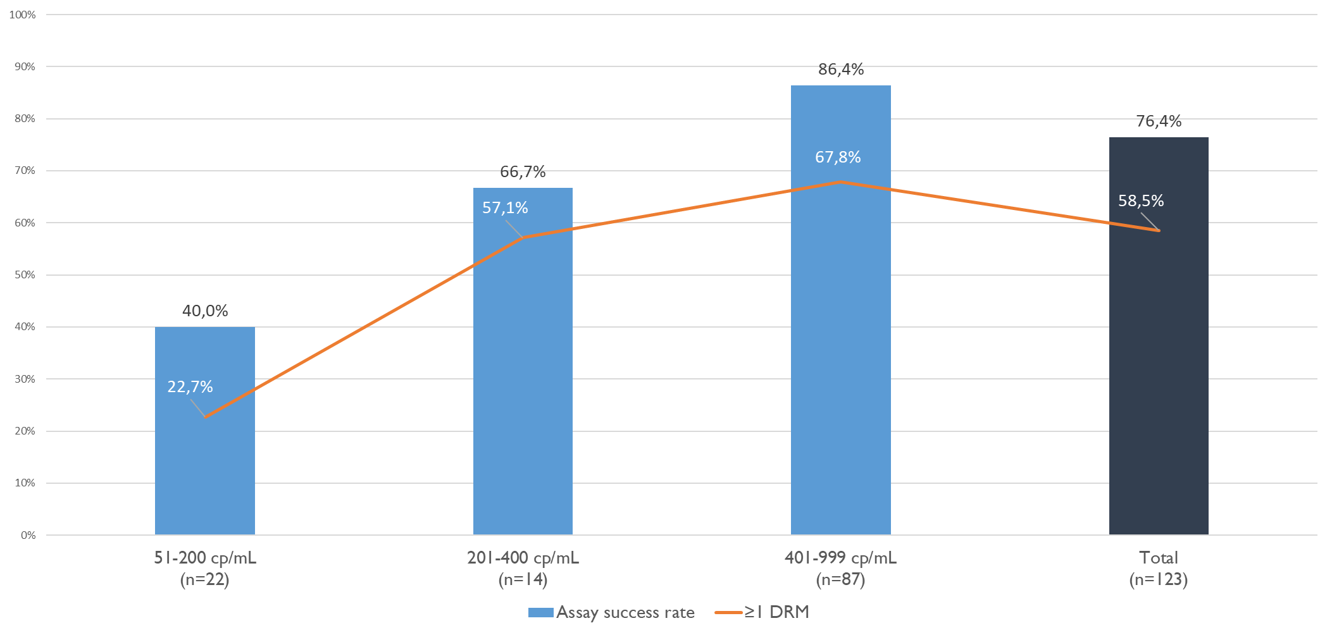
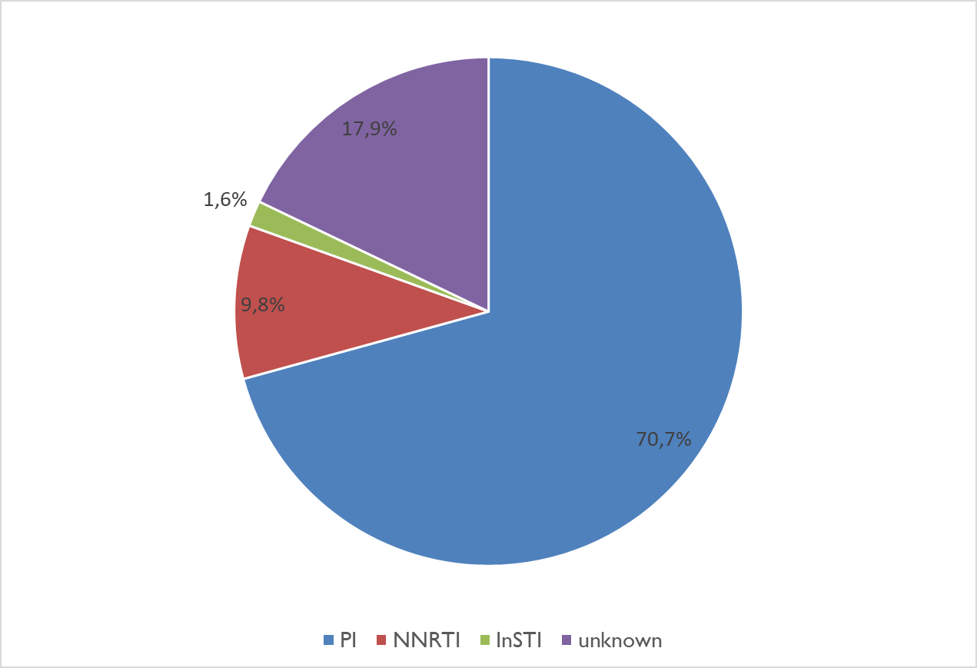
Results
Fig 1 Genotyping success rates and prevalence of DRMs in patients with LLV
Fig 2 ART drug regimens for patients with LLV at the time of genotyping
LLV 7.6% (123/1 614) of total HIVDR request , increasing success as VLs
69.1% had ≥1 major NRTI mutation while 68.1% had ≥1 NNRTI mutations, major PI mutations in 9.6% (n=9/94)

Slide 6
Conclusion
Genotyping at LLV in this setting is feasible
Implementation could result in earlier identification and referral of patients requiring third- line regimens.
Limitations: relatively small sample size, retrospective study design, limited clinical data
This study has limited power to inform public health policy regarding the management of LLV, but it may guide the decision to offer genotypic analysis at lower VLs at a patient level management.
Findings need to be confirmed prospectively with a larger cohort and longitudinal data

